Slide 1
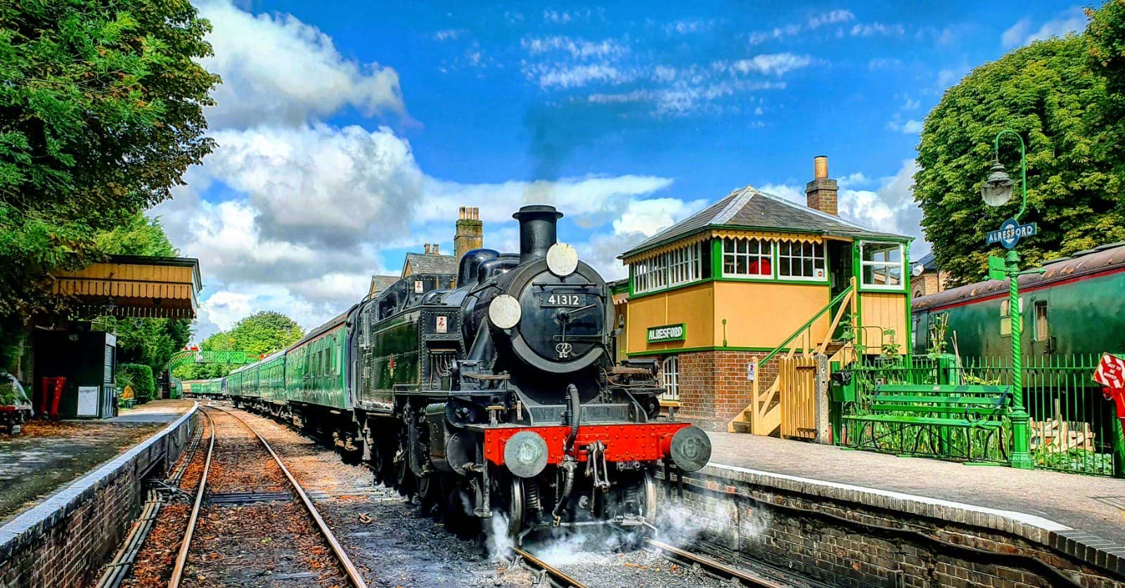
Welcome to the Watercress Line!
A Pre visit visual story and guide for schools and learning groups
education@watercressline.co.uk

Slide 2
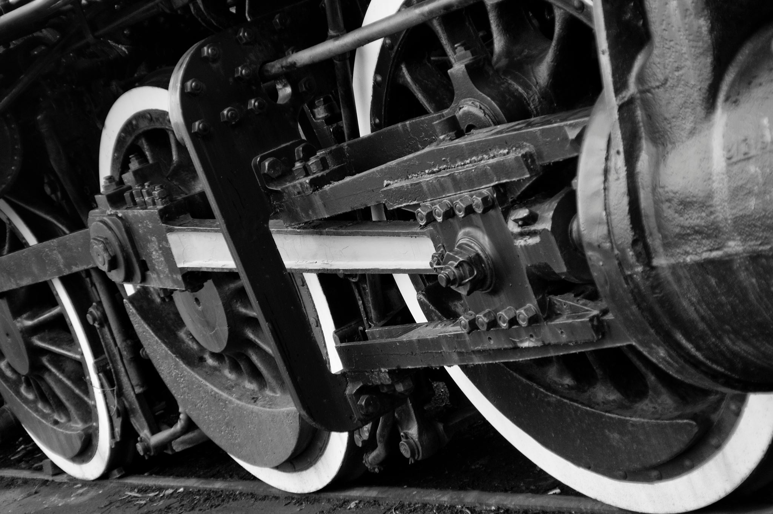
What do we do?
We run Hampshire’s very own steam railway between the towns of Alresford (near to Winchester) and Alton in the east of Hampshire.
We have a collection of over 20 diesel and steam locomotives, some of which we borrow from other railways, others are our own and belong to different groups who look after them and restore them to fully working condition
We have 4 historic stations (Alresford, Ropley, Medstead & Four Marks and Alton) which people can visit to see what was like along the line from the 1930s to the late 1950s.
We look after a fleet of locomotives from the last era of steam to the first generation of diesel locomotives and the all of the railway buildings and things that make the railway work from the 1880s to today.

Slide 3

You will take an exciting trip behind our steam locomotives across the Hampshire countryside – what will you see and hear?

Slide 4
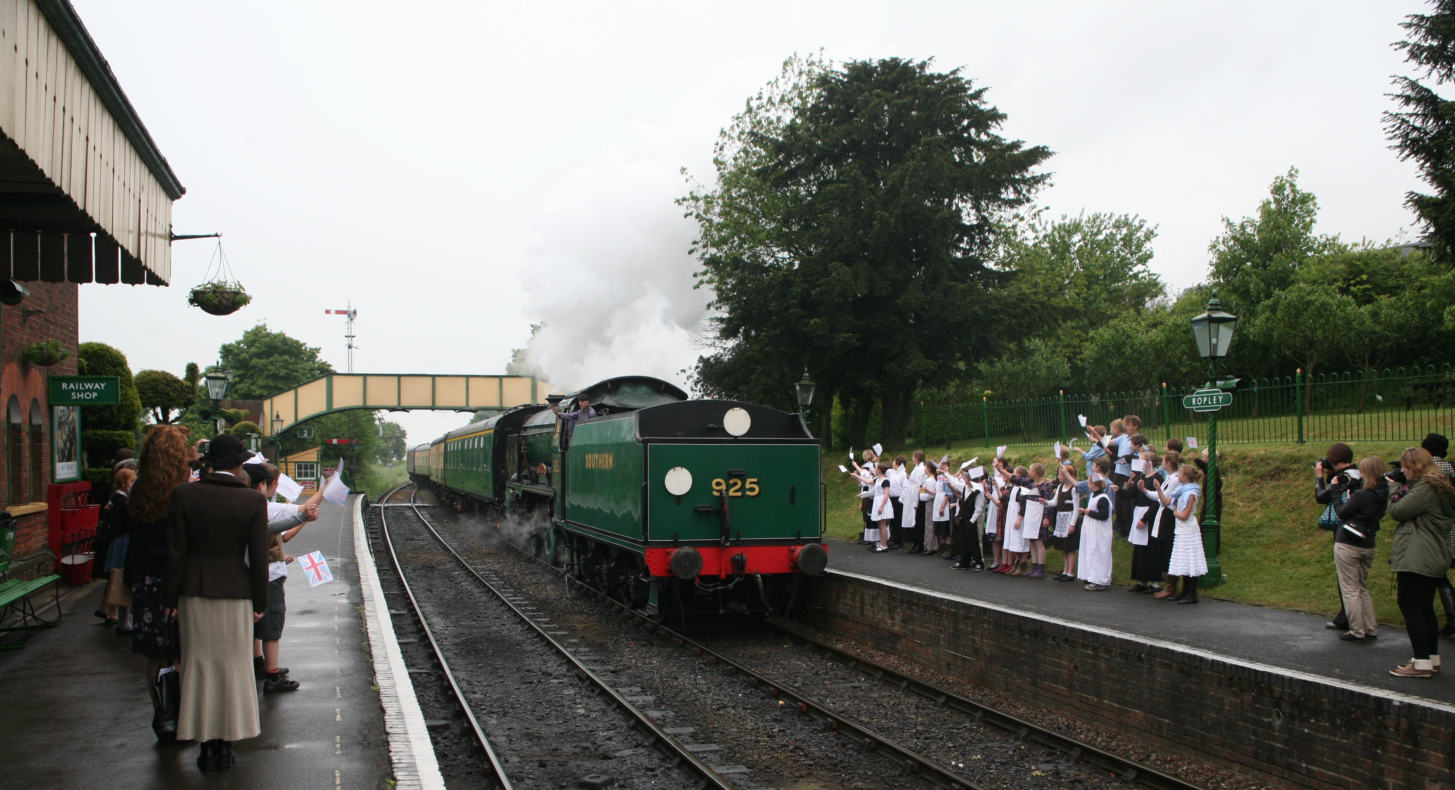
You will have the chance to explore our historic station at Ropley which is home to our locomotives and learning workshops

Slide 5
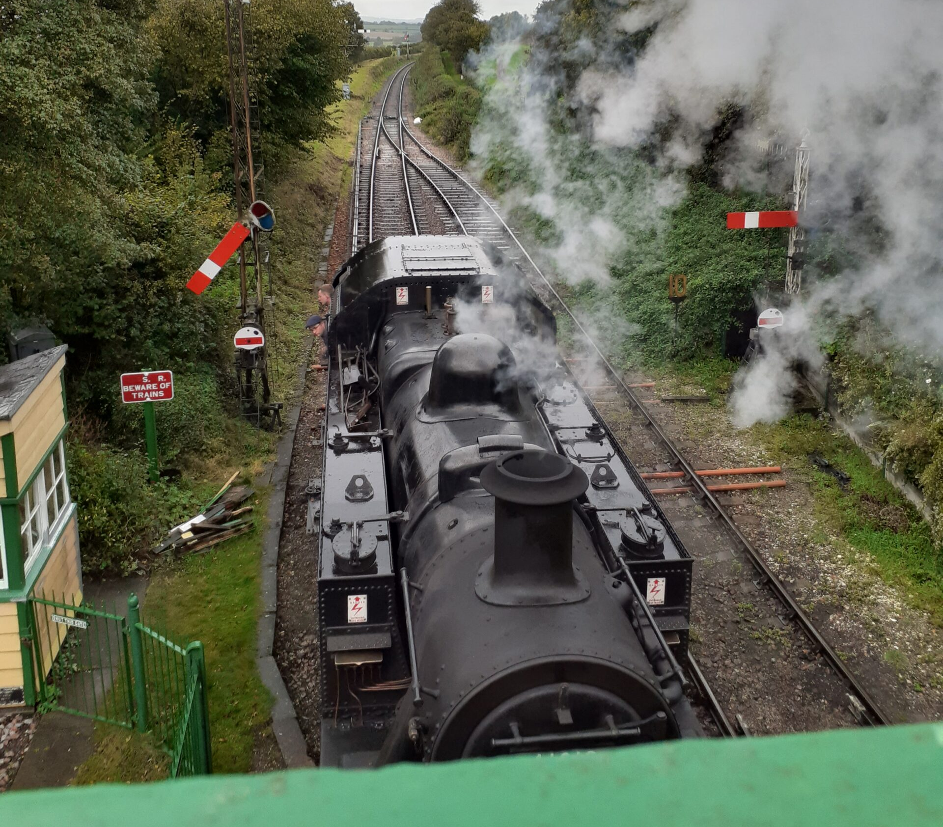
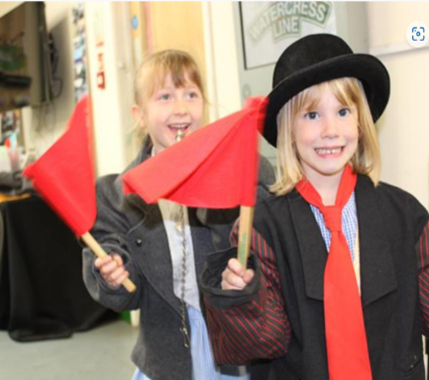
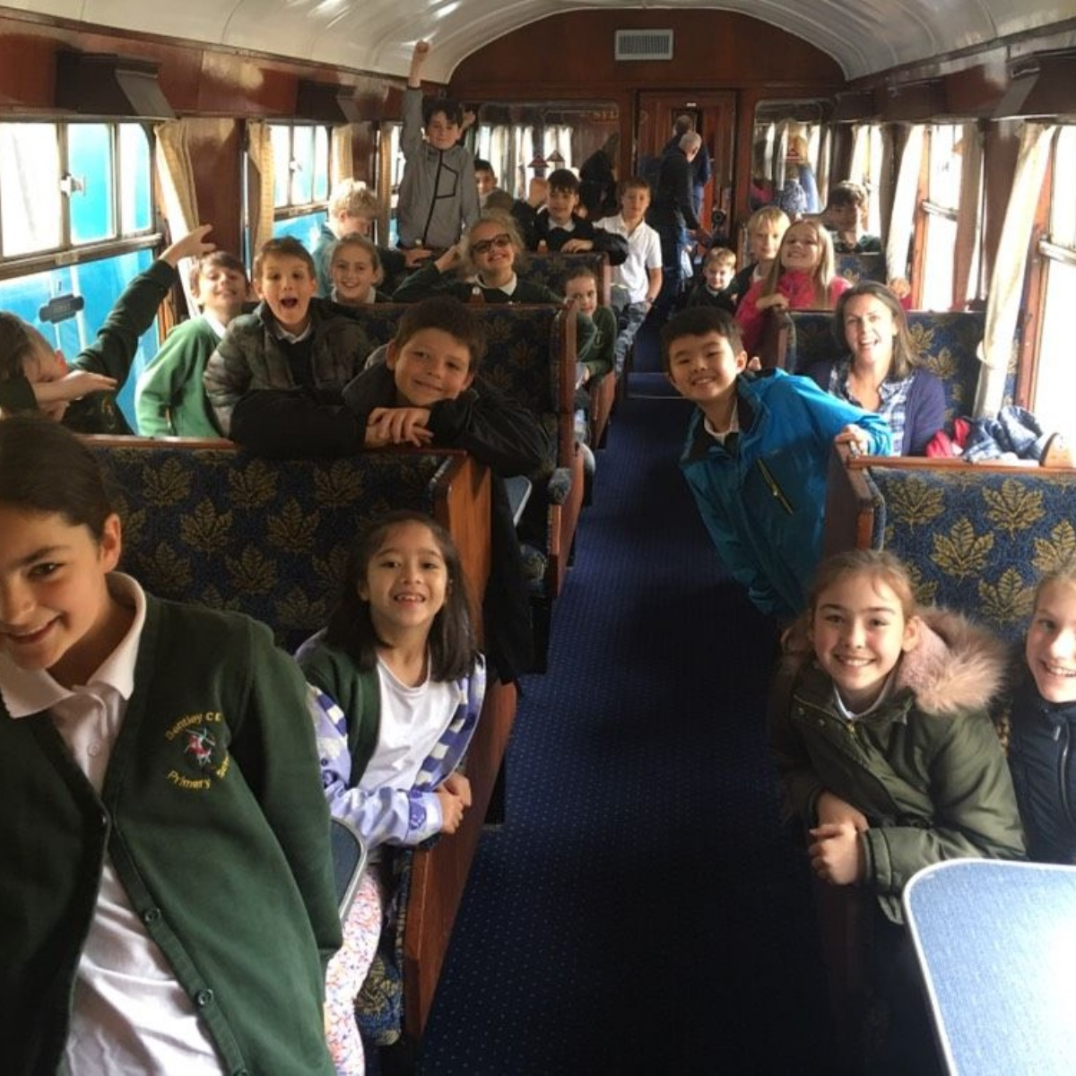
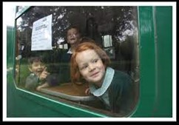
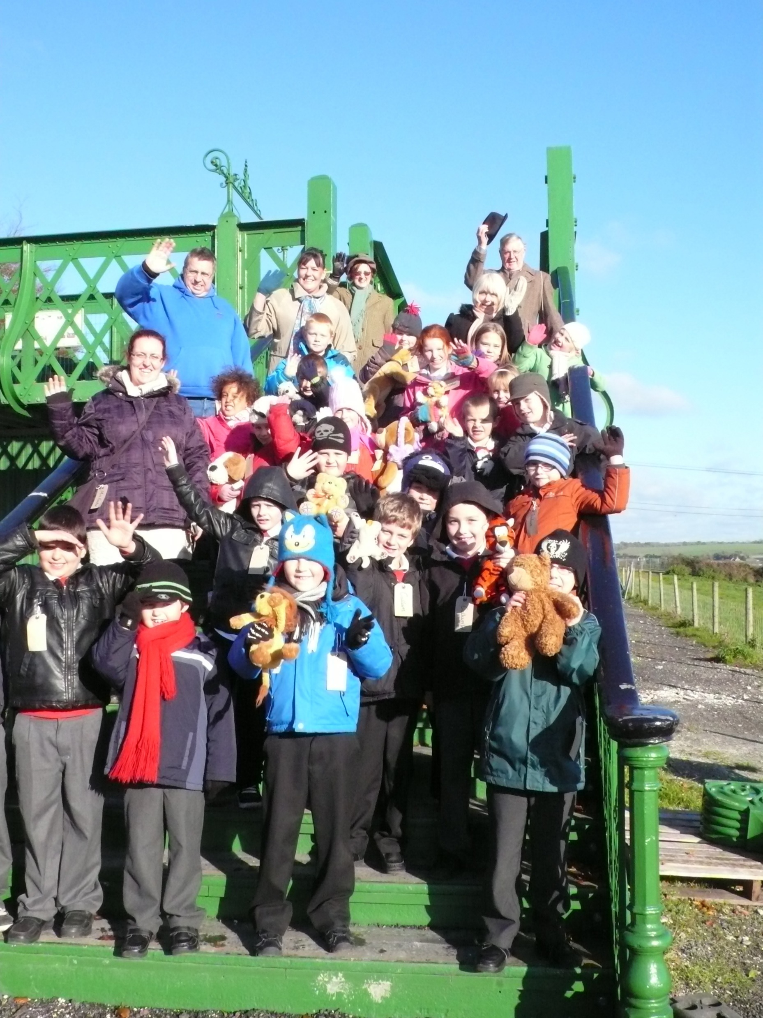

Slide 6
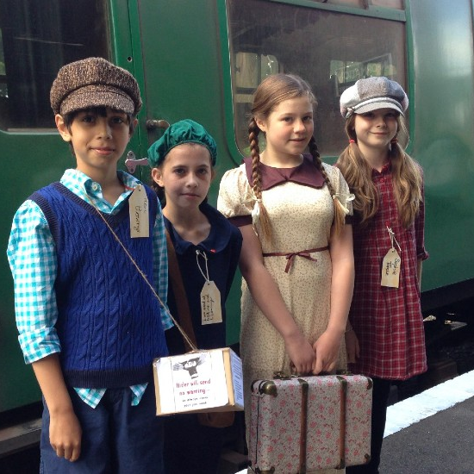
When you arrive…..
You will be met by members of the Education team in our top car park at Ropley or at your starting station (if different)
The education team will welcome everyone and give you a health and safety briefing about what to expect and what you will see and do during your visit
You will visit the toilets and leave your bags in our waiting room before catching the first train of the day up to Alton.
At Alton you can hop off the train and see the historic locomotive swap ends and attach back onto the train to bring it back to Ropley station
Then there will be a lunch break and workshop session which are often held in our viewing gallery and education space and other spaces on Platform No.2

Slide 7
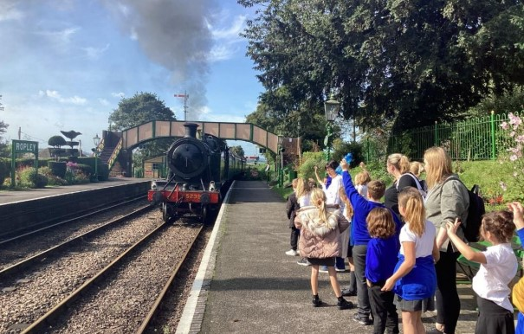

Slide 8
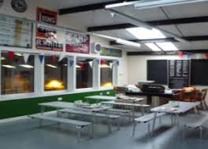
What to expect from a visit: workshops
After your train trip you will be met by a staff member and will visit the viewing gallery and education space which is right next door to the Engine shed
We will do a rotation of activities (the activities are dependent on which topic and workshop your teacher has booked as part of your visit).

Slide 9
What to expect from a visit: Self led
A member of the education team will meet you at our top car park at Ropley or starting station (if starting elsewhere)
You will visit the toilets before catching the first train of the day up and down the railway.
Once you have completed your railway journey, a member of the education team will be on hand at Ropley to answer any questions or queries that you might have about the railway, its history, engines and stories.

Slide 10
Our education workshops: for more details see www.watercressline.co.uk/education-experiences
Operation Pied Piper: escape to the country: dress an evacuee and come to the countryside. Discover and imagine what it was like for children to be sent away to unknown places in the country! Take part in our make do and mend, wartime music, packing a suitcase and guessing the rations. Also meet an evacuee (dependent on availability). Do some fire guard training with our resident ARP warden
Victorians and the railway: discover when, how and why the railway was built in this part of Hampshire, what effects and benefits did it bring to the area and why is the railway called the Watercress Line.
Little Locos express: discover some of the jobs that railway people do, can you fit together the cogs and gears to make them go and help build a giant bridge using the foam bricks for the train to cross

Slide 11

We look forward to welcoming you to the railway soon

Slide 12
Welcome to the Watercress Line!
A Pre visit visual story and guide for schools and learning groups
education@watercressline.co.uk

