Slide 1
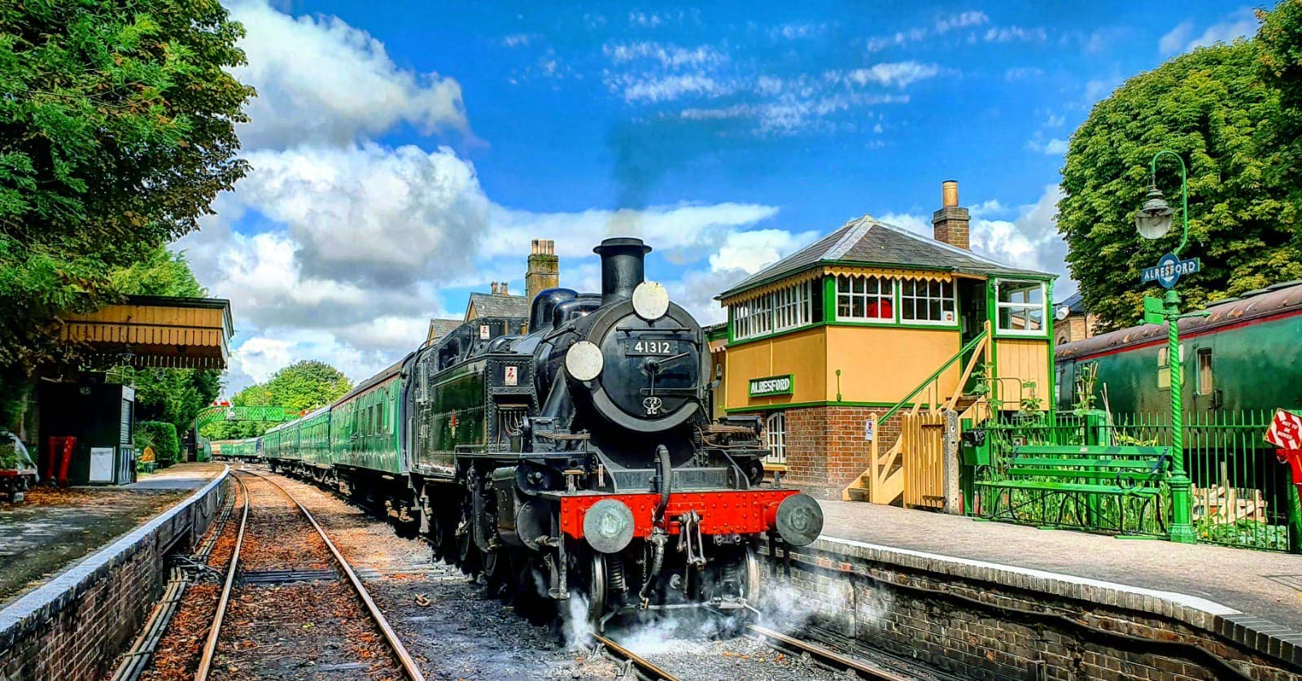
How a steam locomotive work – what makes it move?
A pre visit guide

Slide 2
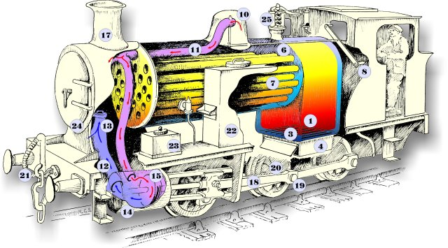
How a steam locomotive works

Slide 3
How a locomotive works
Main Steam Pipe
Exhaust Pipe
Blast Pipe
Cylinder
Piston
Slide valve
Chimney
Connecting Rod
Crank
Driving Wheels
Steam pipe for train brakes
Side water tanks
Sand Box, for traction on wet rails
Smoke Box
Safety Valve
Firebox
Firebox Door
Firebars / Grate
Ashpan
Coal
Water
Firetubes
Regulator
Manifold for other steam equipment (ie. whistle, breakes, blower, etc)
Steam dome

Slide 4
Making the locomotive move..
A steam engine uses a coal fire (although there are some exceptions) as its source of energy to boil water and make steam.
The hot gases from the burning coal in the firebox are passed through the boiler in ‘fire tubes’), before leaving the engine via the smoke-box and chimney.
As the water in boils, the hot “wet” steam rises, and is collected from the steam dome on top of the boiler through the regulator valve, which the driver uses to control the locomotives speed.
From the regulator, steam is piped to the cylinders, and is admitted alternatively via the valve-chests (located on the side of the Cylinder housing), pushing the piston in the Cylinder back and forth.
The piston is connected to the driving wheels via the ‘connecting rod’ and ‘crank’ (or ‘valve gear’ as it is commonly called), and the to-and-fro motion of the piston turns the driving wheels. Each time the cylinder piston moves back and forth, the driving wheel completes a full rotation.
The ‘crank’ linkage on each side of the loco is offset by 90 degress to prevent it from jamming if the loco stop with them in the horizontal position.

Slide 5
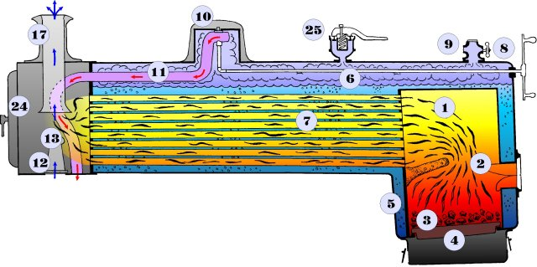

Slide 6
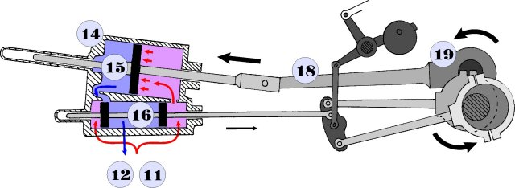
After leaving the cylinder, the spent steam escapes from the engine via the blast-pipe and up into the chimney in the smokebox. The action of steam in the blast-pipe creates a lower pressue in the smoke-box, and helps to draw the hot gases from the fire through the boiler tubes and in-turn generate more steam.

Slide 7
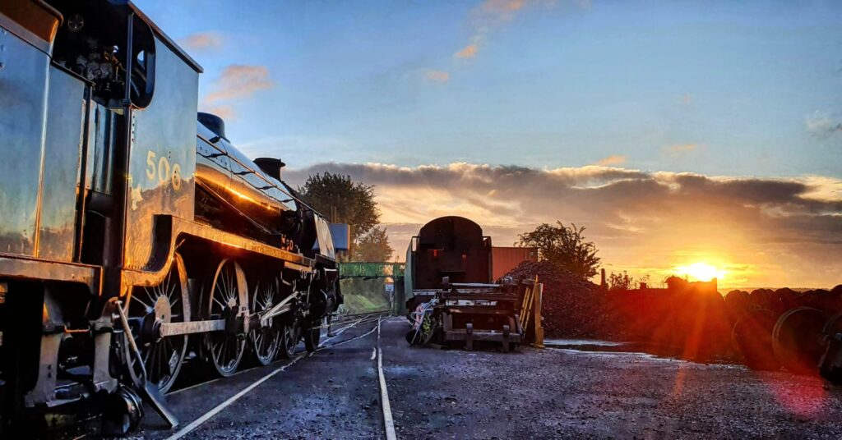
Some of our locomotives

Slide 8
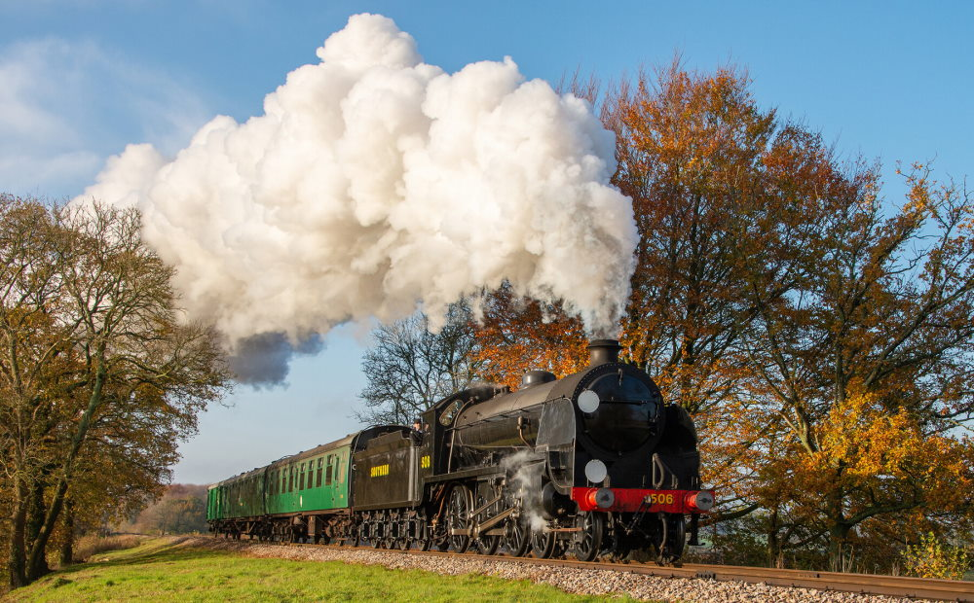

Slide 9
