Slide 1
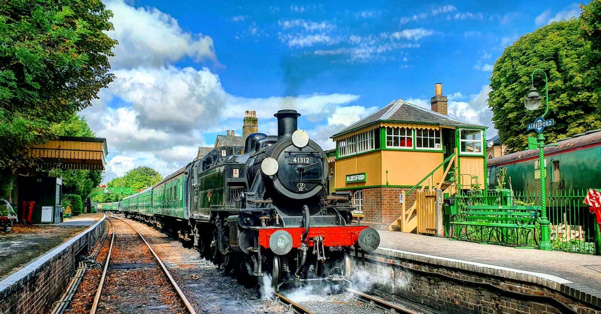
The Watercress Line during wartime
Pre visit guide for schools and learning groups

Slide 2
Was the railway still working during the war?

Slide 3
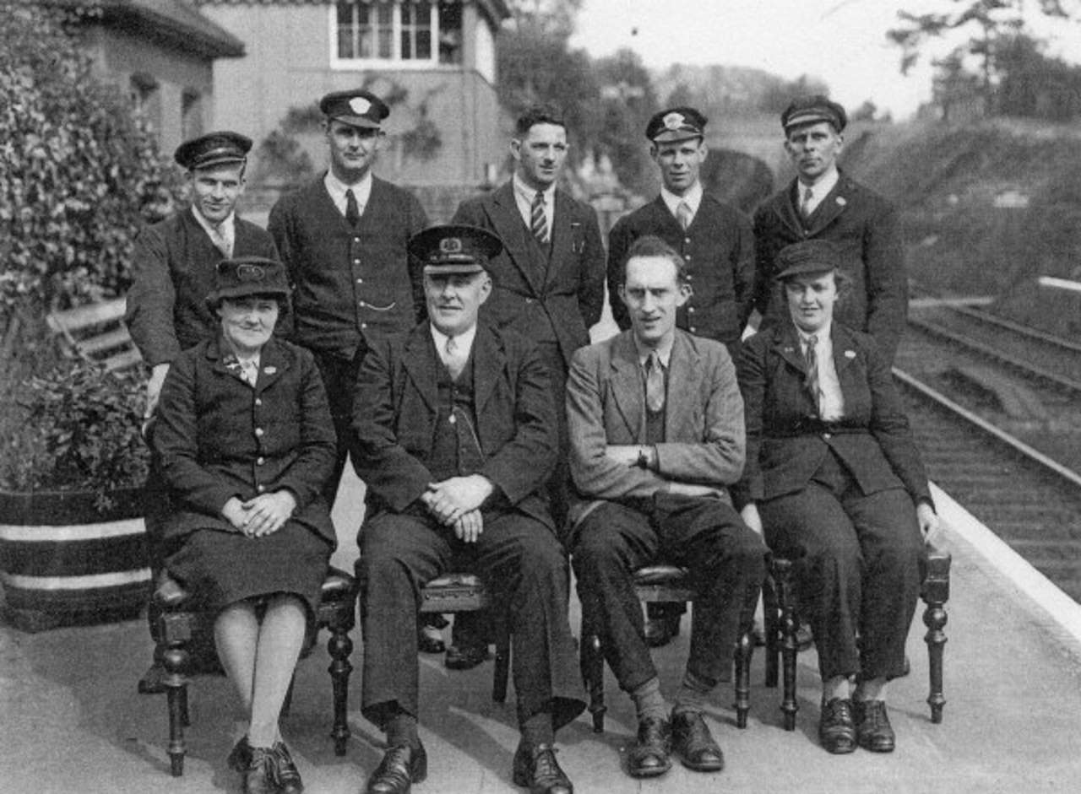
World War Two
People
Tanks
Kit & Equipment
Troops to Southampton
Evacuees

Slide 4
Quiz time!
Which Prime Minister met other world leaders near our railway (on the Meon Valley Line) in a train carriage hidden from the public towards the end of World War Two?

Slide 5
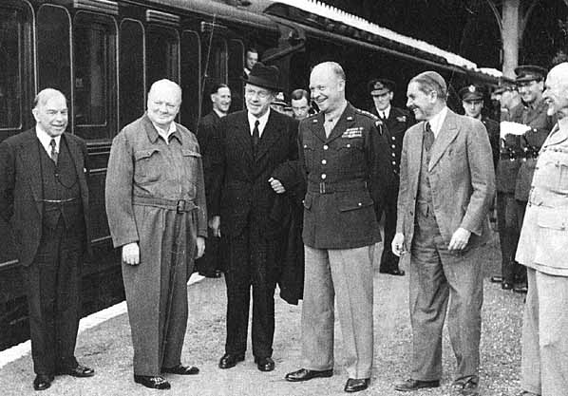

Slide 6
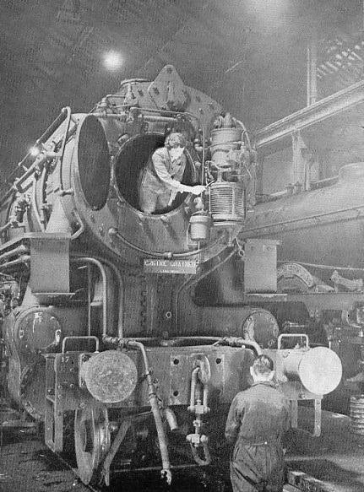
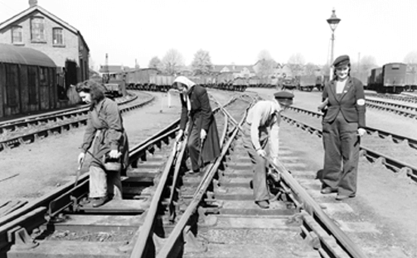
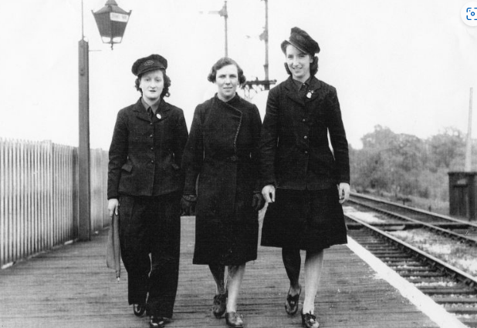
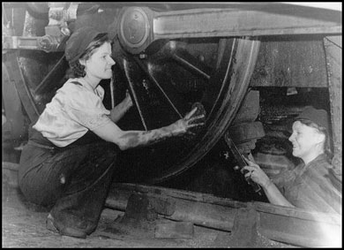

Slide 7
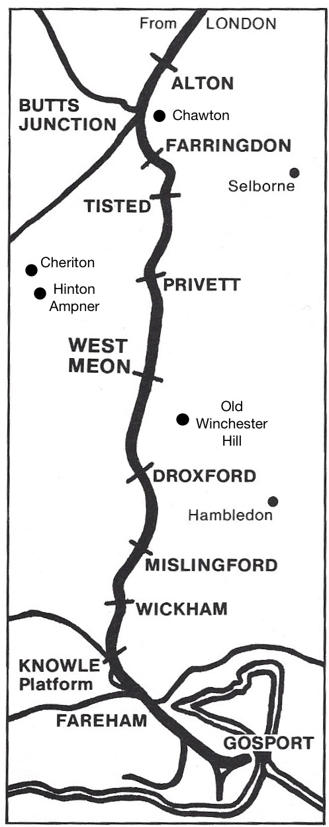

Slide 8


Slide 9
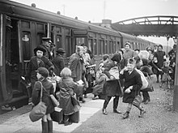
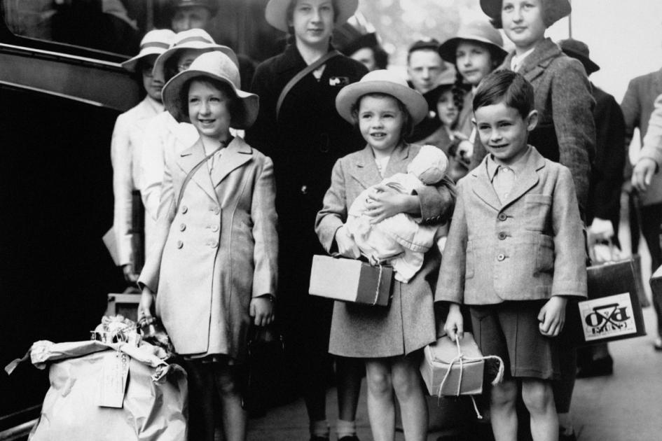
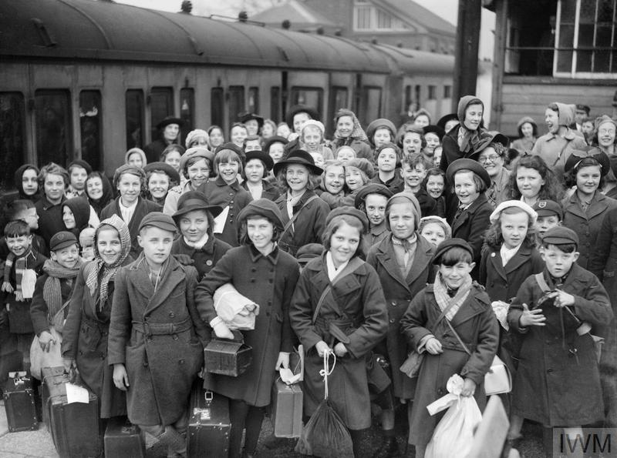

Slide 10
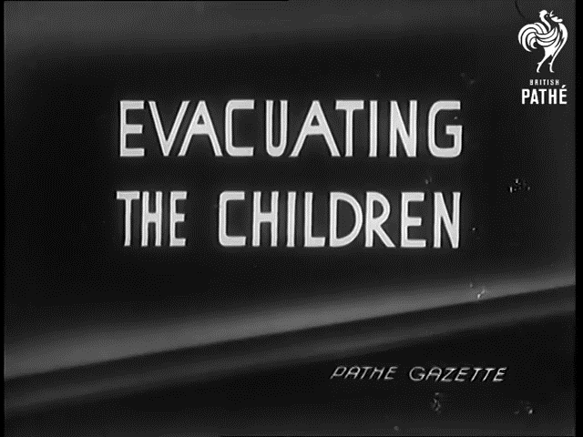

Slide 11
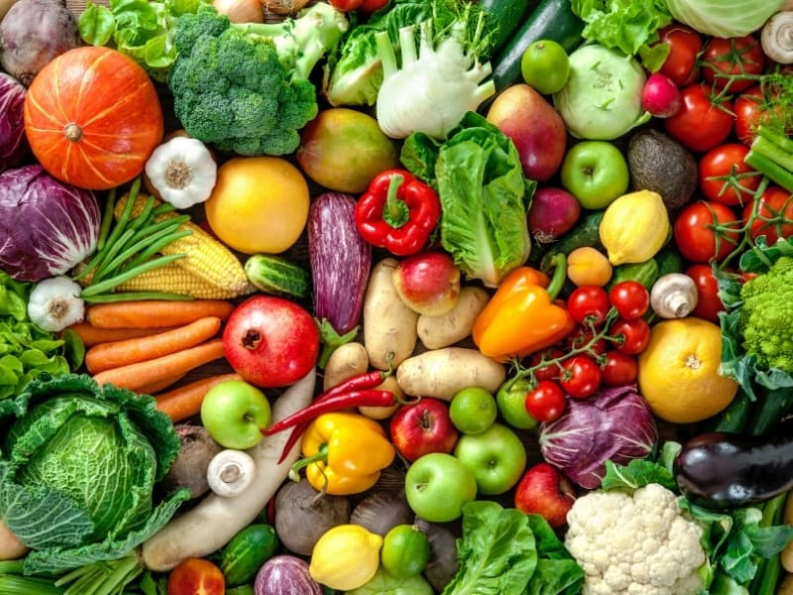
Which vegetable did the Alresford station master encourage local villagers to grow at the station during world war two?
Cucumbers
Tomatoes
Sweet Peas
Avocadoes

Slide 12
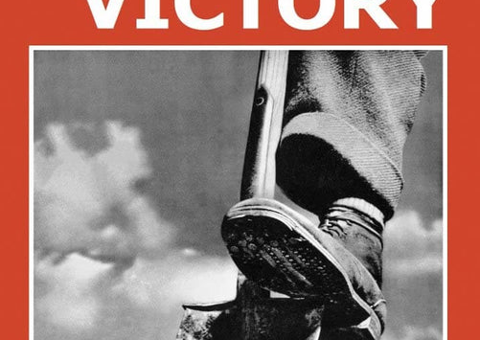
Which vegetable did the Alresford station master encourage local villagers to grow at the station during world war two?
Cucumbers
Tomatoes
Sweet Peas
Avocadoes

